Slide 1

Database Processing: Fundamentals, Design, and Implementation
15th Edition
Chapter One
Introduction

Slide 2

Bill Gates

Slide 3
Learning Objectives (1 of 2)
1.1 To understand the importance of databases in Internet Web applications and smart-phone apps
1.2 To understand the nature and characteristics of databases
1.3 To survey some important and interesting database applications
1.4 To gain a general understanding of tables and relationships
1.5 To describe the components of a Microsoft Access database system and explain the functions they perform
1.6 To describe the components of an enterprise-class database system and explain the functions they perform
1.7 To define the term database management system (DBMS) and describe the functions of a DBMS
1.8 To define the term database and describe what is contained within the database

Slide 4
Learning Objectives (2 of 2)
1.9 To define the term metadata and provide examples of metadata
1.10 To define and understand database design from existing data
1.11 To define and understand database design as new systems development
1.12 To define and understand database redesign of an existing database
1.13 To understand the history and development of database processing

Slide 5
How Did We Get Here? The Internet World I
Personal Computers
1977: Apple II
1981: IBM PC
Local Area Networks
Ethernet networking technology
Early 1970s: Xerox Palo Alto Research Center
1983: U.S. National Standard

Slide 6
How Did We Get Here? The Internet World II
The Internet
1969: ARPANET
World Wide Web (WWW)
1993: First Web browser (Netscape) available
Mid 1990s: Online retail sites
1995: Amazon
Followed by Best Buy
Early 2000s: Web 2.0

Slide 7
How Did We Get Here? The Smartphone World
Mid 1970s: Mobile Phone (Cell Phone)
Smartphone
2007: Apple iPhone
2008: Google Android Operating System
Tablets
2010: Apple iPad
Apps
All of these examples depend on databases

Slide 8
Databases in the Internet and Mobile Device World
Databases are important because they are everywhere and are used daily:
Facebook
Posts
Likes
Twitter
Tweets
Online shopping
Amazon.com – [Do an actual search]

Slide 9
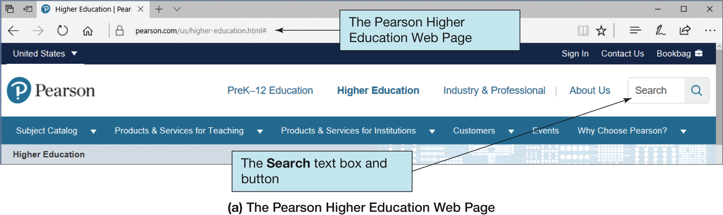
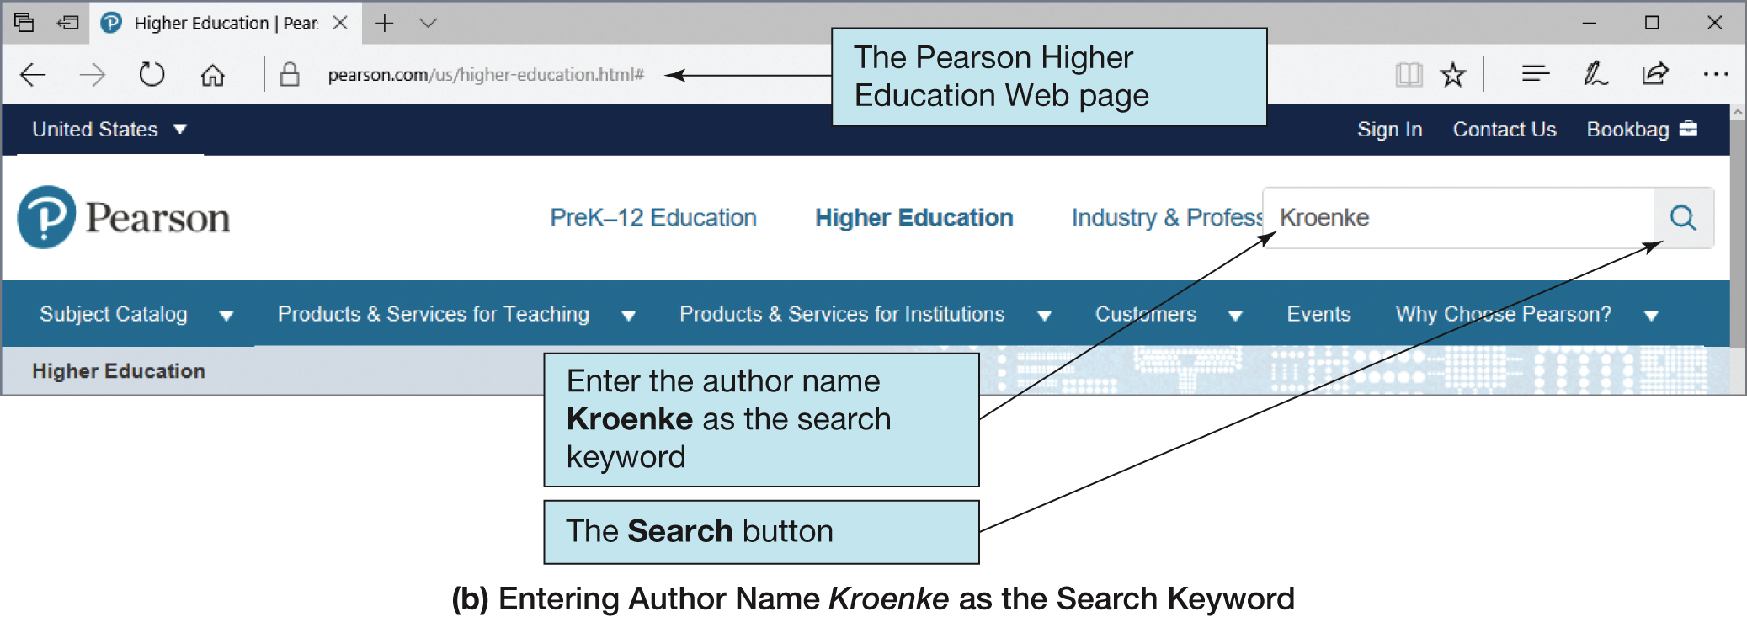
Figure 1-1 Searching a Database in a Web Browser (1 of 2)

Slide 10
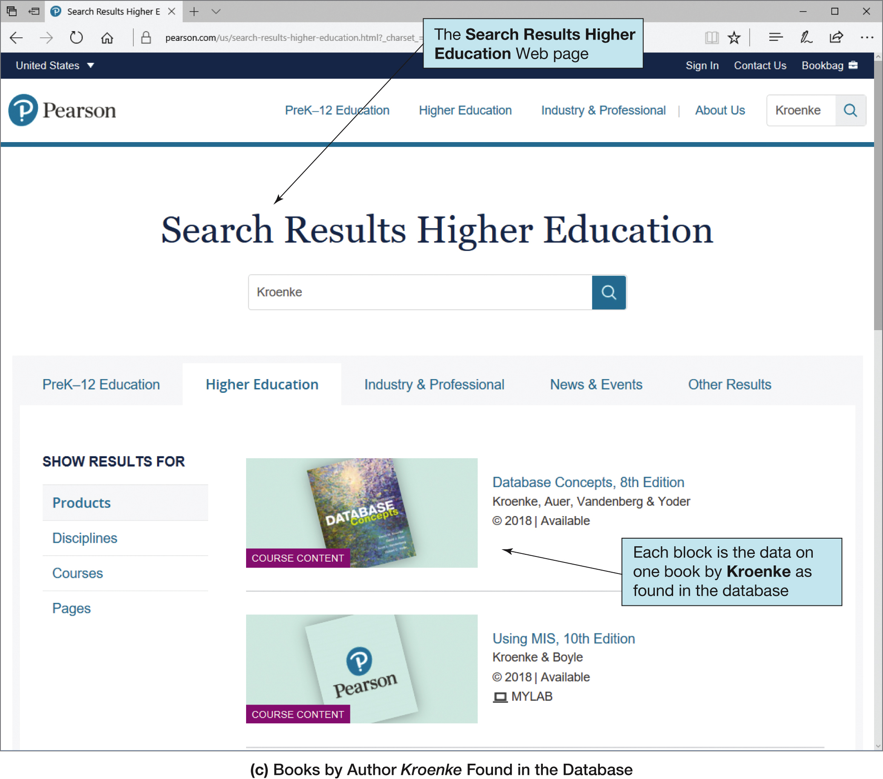
Figure 1-1 Searching a Database in a Web Browser (2 of 2)

Slide 11
The Characteristics of Databases
The purpose of a database is to help people track things of interest to them.
Data is stored in tables, which have rows and columns like a spreadsheet.
A database may have multiple tables, where each table stores data about a different thing.
Each row in a table stores data about an occurrence or instance of the thing of interest.
A database stores data and relationships.

Slide 12
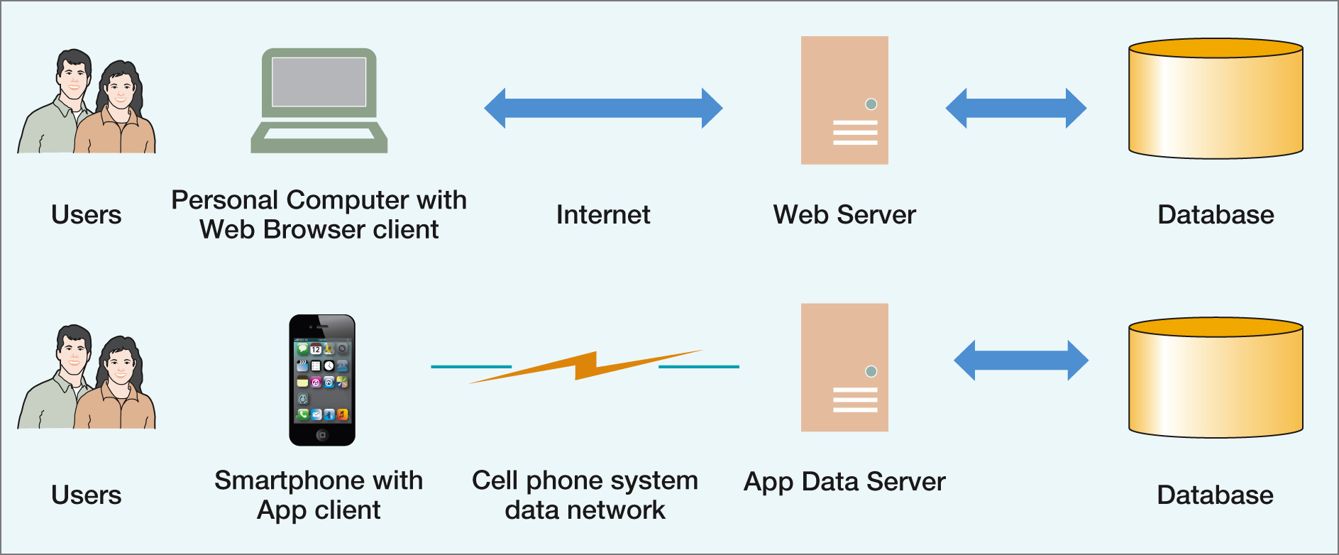
Figure 1-2 The Internet and Mobile Device World

Slide 13
Naming Conventions in this Textbook
Table names are written with all capital letters:
STUDENT, CLASS, GRADE, COURSE_INFO
Column names are written with an initial capital letter, and compound names are written with a capital letter on each word:
Term, Section, ClassNumber, StudentName

Slide 14
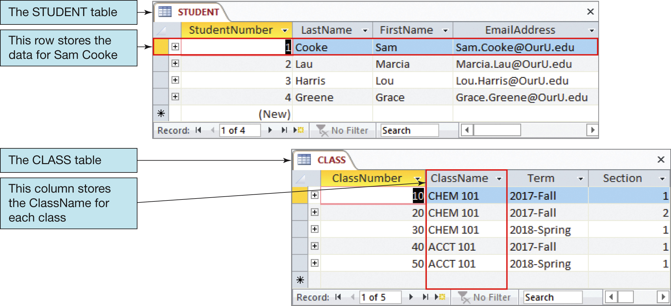
Figure 1-3 The STUDENT and CLASS Tables

Slide 15
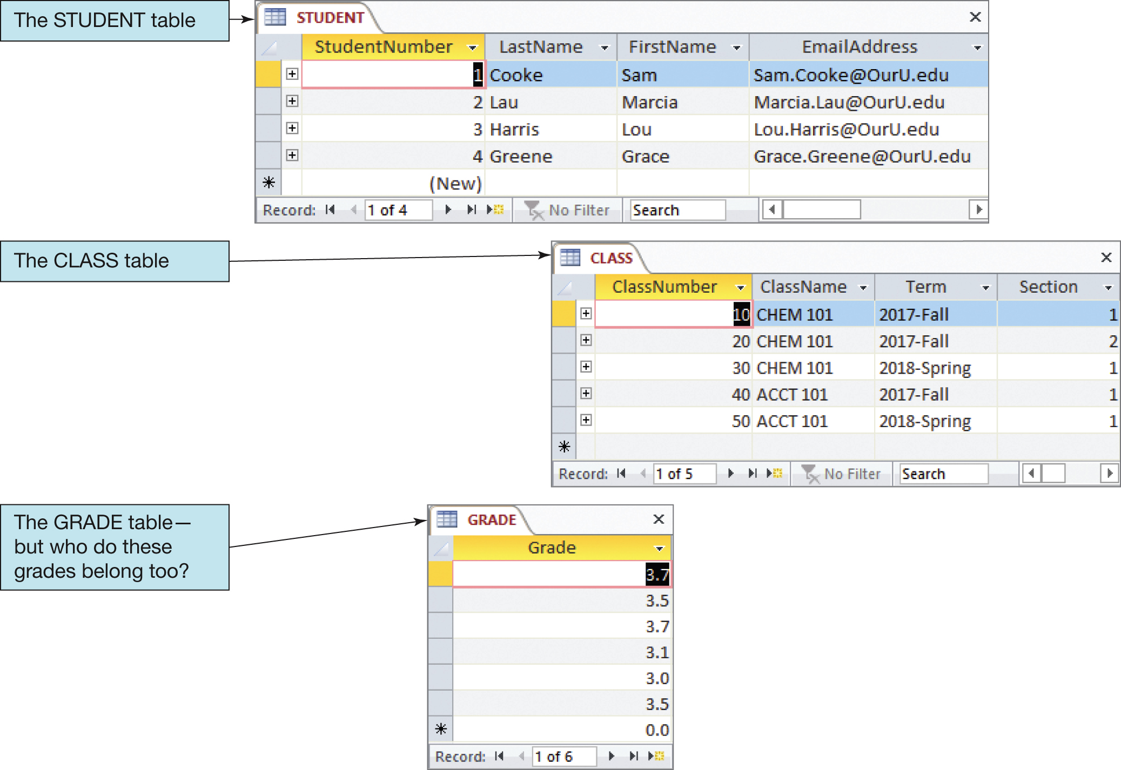
Figure 1-4 The STUDENT, CLASS, and GRADE Tables

Slide 16
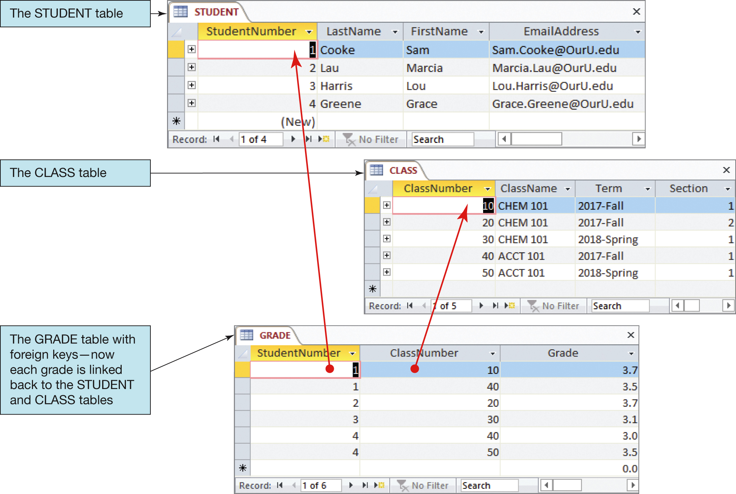
Figure 1-5 The Key Database Characteristics: Related Tables

Slide 17
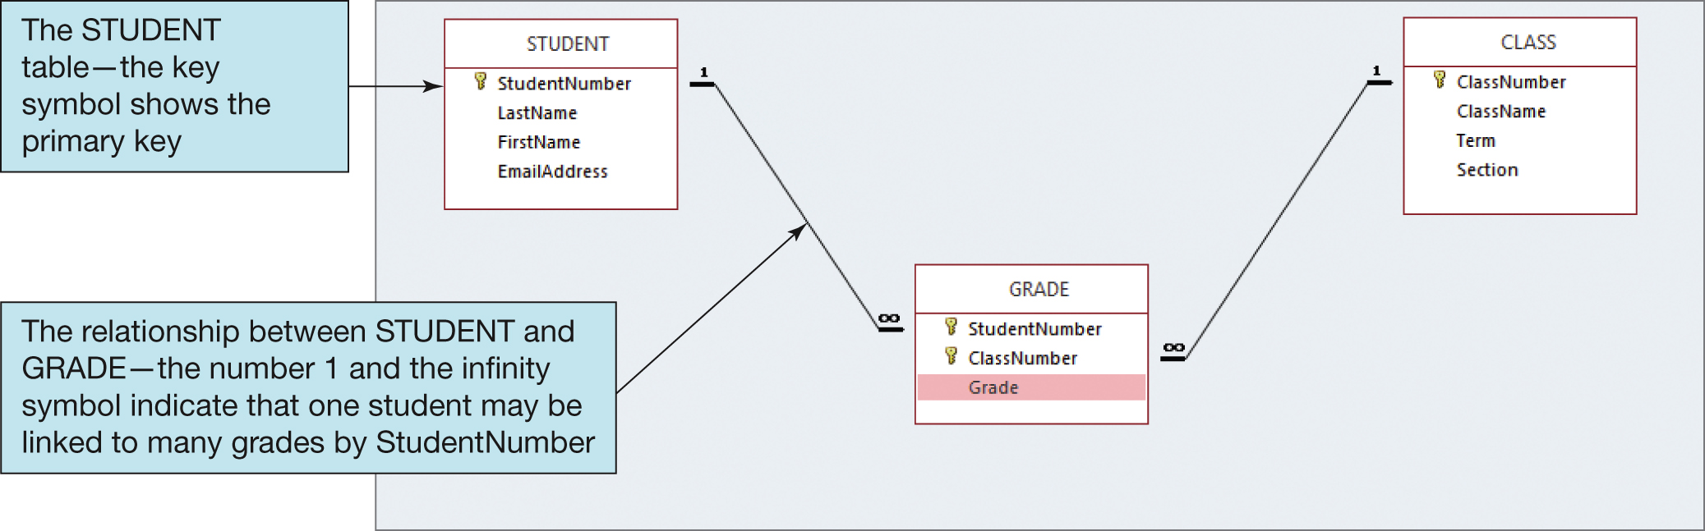
Figure 1-6 Microsoft Access 2016 View of Tables and Relationships

Slide 18
Databases Create Information
Data = recorded facts and figures
Information = knowledge derived from data
Databases record data, but they do so in such a way that we can produce information from the data
The data on STUDENTs, CLASSes, and GRADEs could produce information about each student’s GPA.

Slide 19
Figure 1-7 Example Database Applications
Application | Example Users | Number of Users | Typical Size | Remarks
Sales Contact Manager | Salesperson | 1 | 2,000 rows | Products such as GioldMine and Act! Are database centric
Patient appointment (doctor, dentist) | Medical office | 15 to 50 | 100,000 rows | Vertical market software vendors incorporate databases into their software products
Customer relationship management (CRM) | Sales, marketing, or customer service departments | 500 | 10 million rows | Major vendors such as Microsoft and Oracle PeopleSoft Enterprise build applications around the database
Enterprise resource planning (ERP) | An entire organization | 500 | 10 million+ rows | SAP uses a database as a central repository for ERP data.
E-commerce site | Internet users | Possibly millions | 1 billion+ rows | Drugstore.com has a database that grows at the rate of 20 million rows per day!
Digital dashboard | Senior managers | 500 | 100,000 rows | Extractions, summaries, and consolidations of operational databases.
Data mining | Business analysts | 25 | 100,000 to millions+ | Data are extracted, reformatted, cleaned, and filtered for use by statistical mining tools.

Slide 20
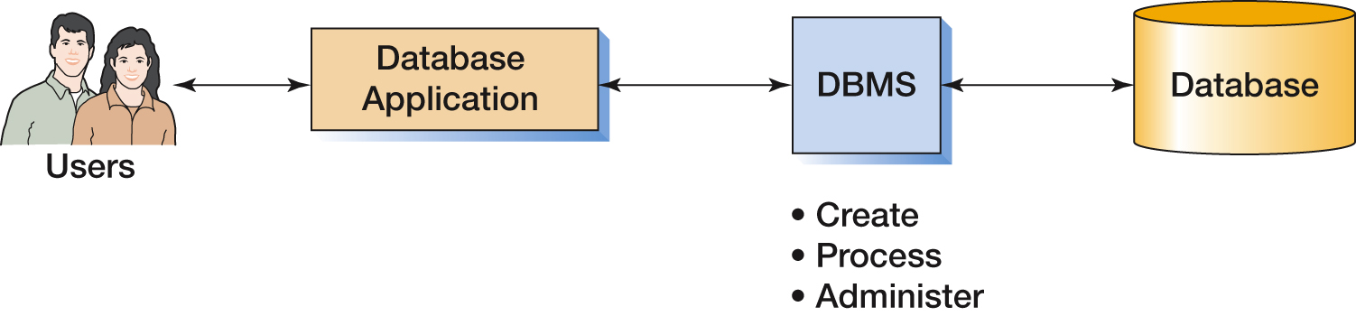
Figure 1-8 The Components of a Database System

Slide 21
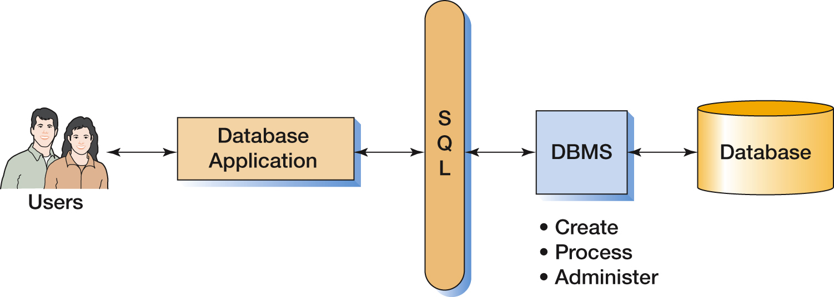
Figure 1-9 The Components of a Database System with SQL

Slide 22
Applications, the DBMS, and SQL
Applications are the computer programs that users work with.
The Database Management System (DBMS) creates, processes, and administers databases.
Structured Query Language (SQL) is an internationally recognized standard database language that is used by all commercial DBMSs.

Slide 23
Figure 1-10 Basic Functions of Application Programs
Basic Functions of Application Programs
Create and process forms
Process user queries
Create and process reports
Execute application logic
Control the application itself

Slide 24
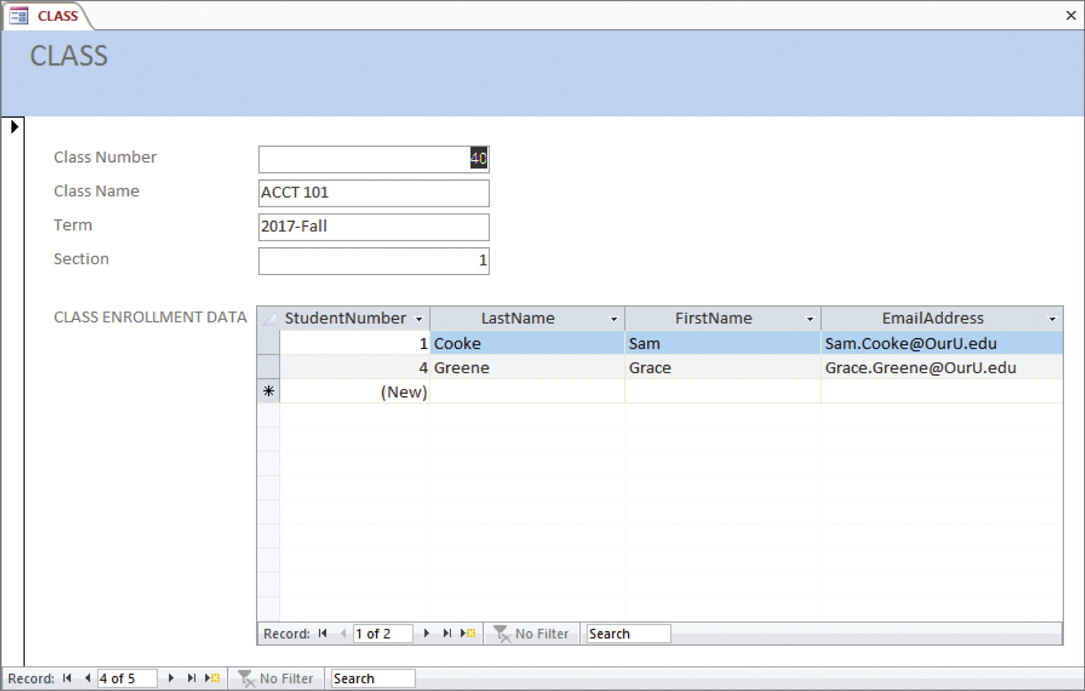
Figure 1-11 An Example Data Entry Form

Slide 25
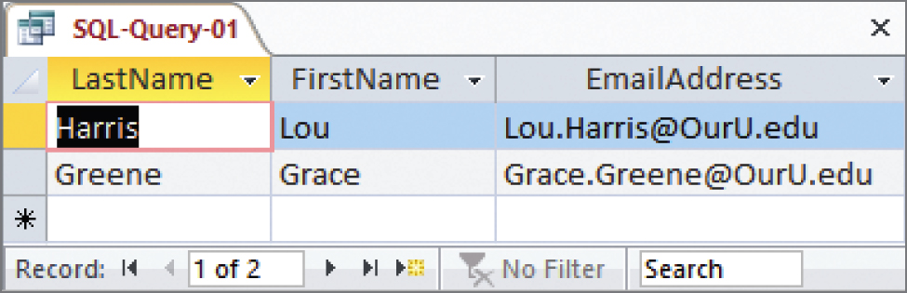
Figure 1-12 Example SQL Query Results

Slide 26
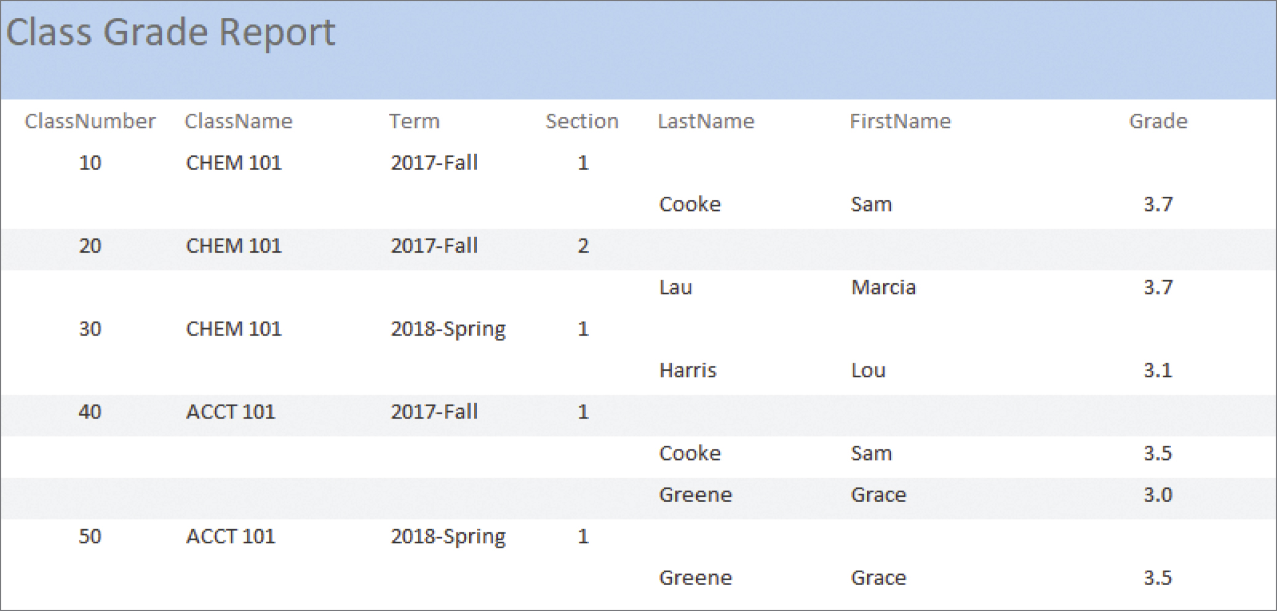
Figure 1-13 Example Report

Slide 27
Figure 1-14 Functions of a DBMS
Functions of a DBMS
Create database
Create tables
Create supporting structures (e.g., Indexes)
Modify (insert, update, or delete) database data
Read database data
Maintain database structures
Enforce rules
Control concurrency
Perform backup and recovery

Slide 28
The Database
A database is a self-describing collection of integrated tables.
The tables are called integrated because they store data about the relationships between rows of data.
A database is called self-describing because it stores a description of itself.
The self-describing data is called metadata, which is data about data.

Slide 29
Figure 1-15 Typical Metadata Tables (1 of 2)
TableName | NumberColumns | PrimaryKey
STUDENT | 4 | StudentNumber
CLASS | 4 | ClassNumber
GRADE | 3 | (StudentNumber, ClassNumber)

Slide 30
Figure 1-15 Typical Metadata Tables (2 of 2)
ColumnName | TableName | DataType | Length (bytes)
StudentNumber | STUDENT | Integer | 4
LastName | STUDENT | Text | 25
FirstName | STUDENT | Text | 25
EmailAddress | STUDENT | Text | 100
ClassNumber | CLASS | Integer | 4
Name | CLASS | Text | 25
Term | CLASS | Text | 12
Section | CLASS | Integer | 4
StudentNumber | GRADE | Integer | 4
ClassNumber | GRADE | Integer | 4
Grade | GRADE | Decimal | (2,1)

Slide 31
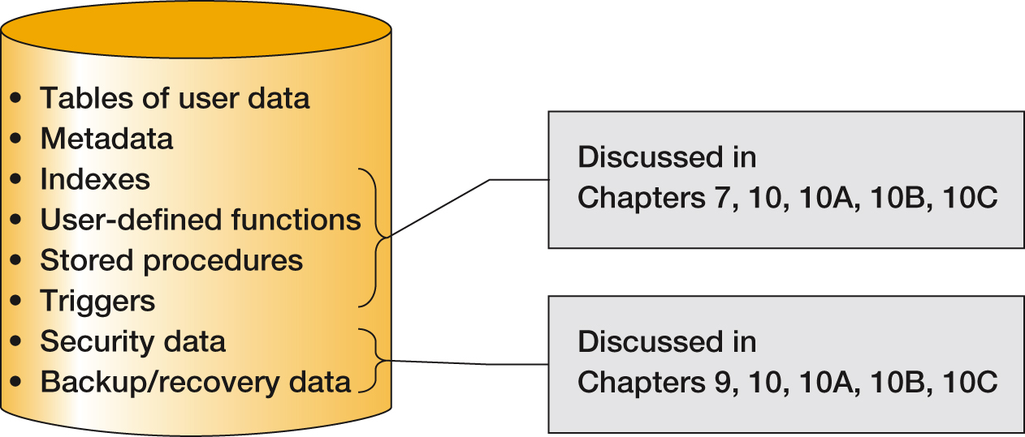
Figure 1-16 Typical Metadata Tables

Slide 32
Microsoft Access
Microsoft Access is a low-end product intended for individual users and small workgroups.
Microsoft Access tries to hide much of the underlying database technology from the user.
This is a good strategy for beginners, but not for database professionals.
NOTE: Microsoft Access 2016 is discussed in detail in Appendix A.

Slide 33
What is Microsoft Access?
Microsoft Access is a DBMS plus an application generator:
The DBMS creates, processes, and administers Microsoft Access databases.
The application generator includes query, form, and report components.
The Microsoft Access DBMS engine is called the Access Data Engine (ADE).
Microsoft Access 2000 thru 2010 can be used as an application generator for the Microsoft SQL Server DBMS.

Slide 34
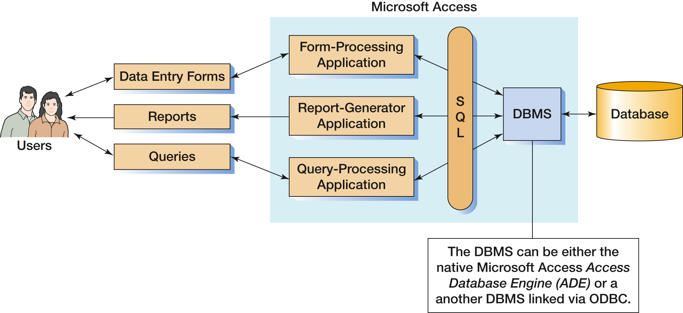
Figure 1-17 Components of a Microsoft Access Database System

Slide 35
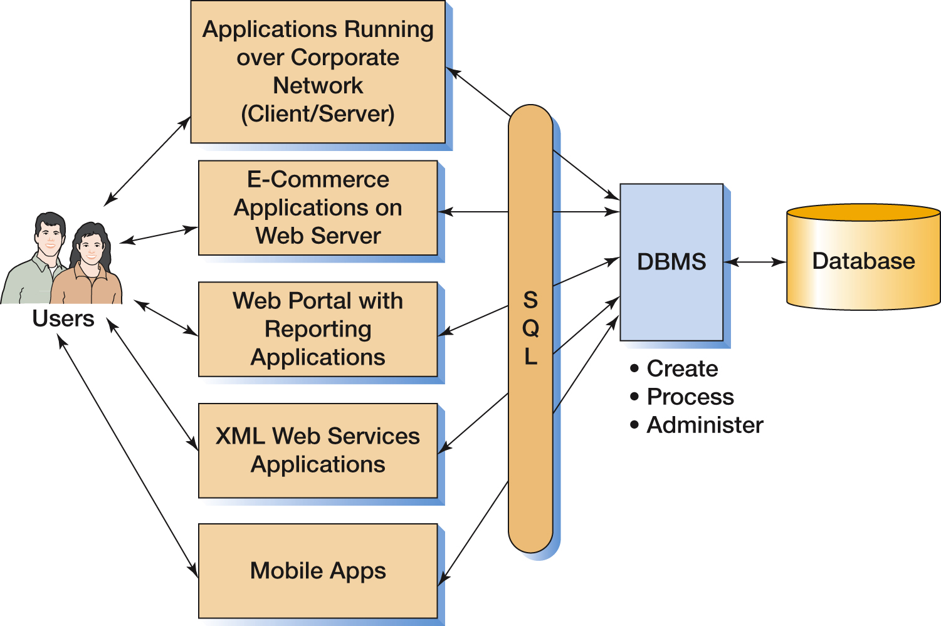
Figure 1-18 Components of an Enterprise-Class Database System

Slide 36
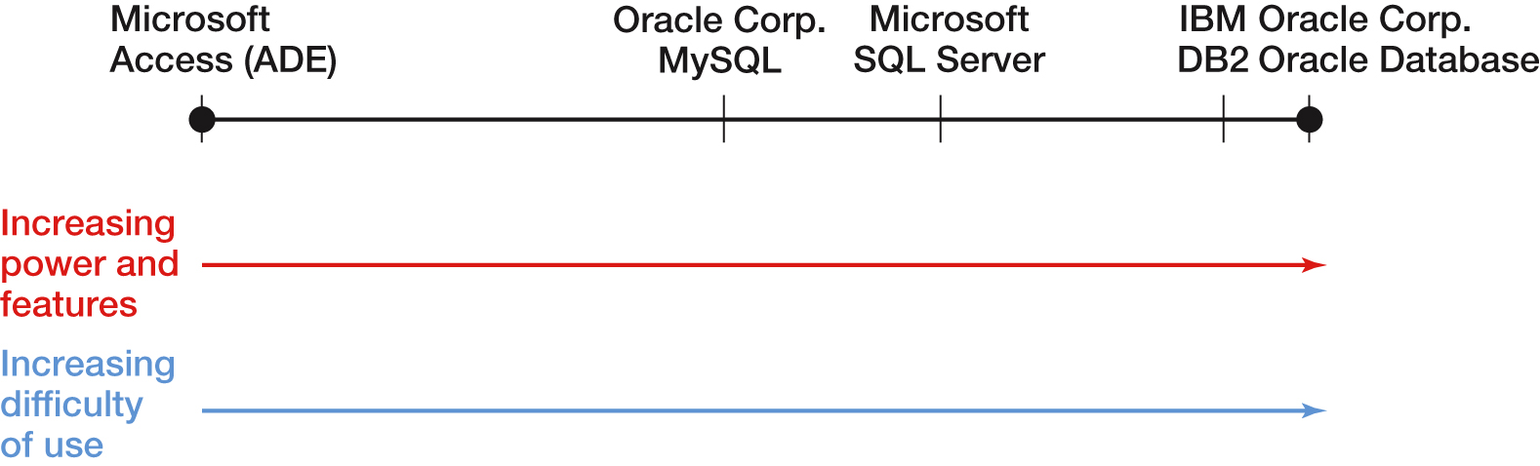
Figure 1-19 Common Professional View of DBMS Products

Slide 37
Figure 1-20 Three Types of Database Design
Types of Database Design Process
From existing data (Chapters 3 and 4)
Analyze spreadsheets and other data tables
Extract data from other databases
Design using normalization principles
New systems development (Chapters 5 and 6)
Crete data model from application requirements
Transform data model into database design
Database redesign (Chapter 8)
Migrate databases to newer databases
Integrate two or more databases
Reverse-engineer and design new database using normalization principles and data model transformation

Slide 38
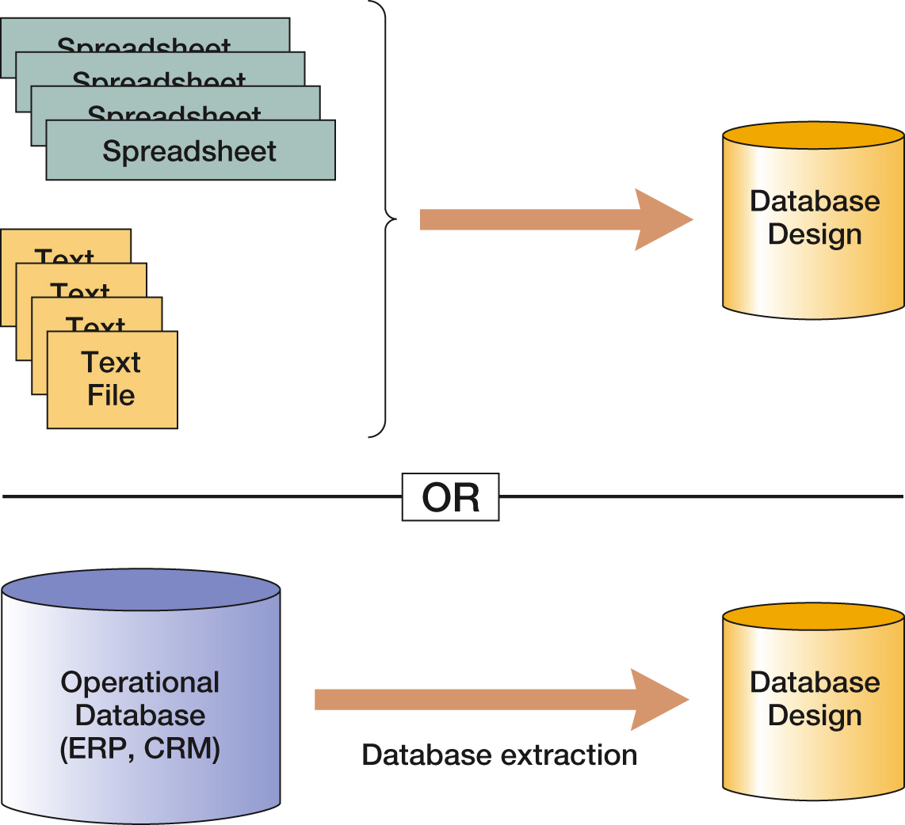
Figure 1-21 Databases Originating from Existing Data

Slide 39
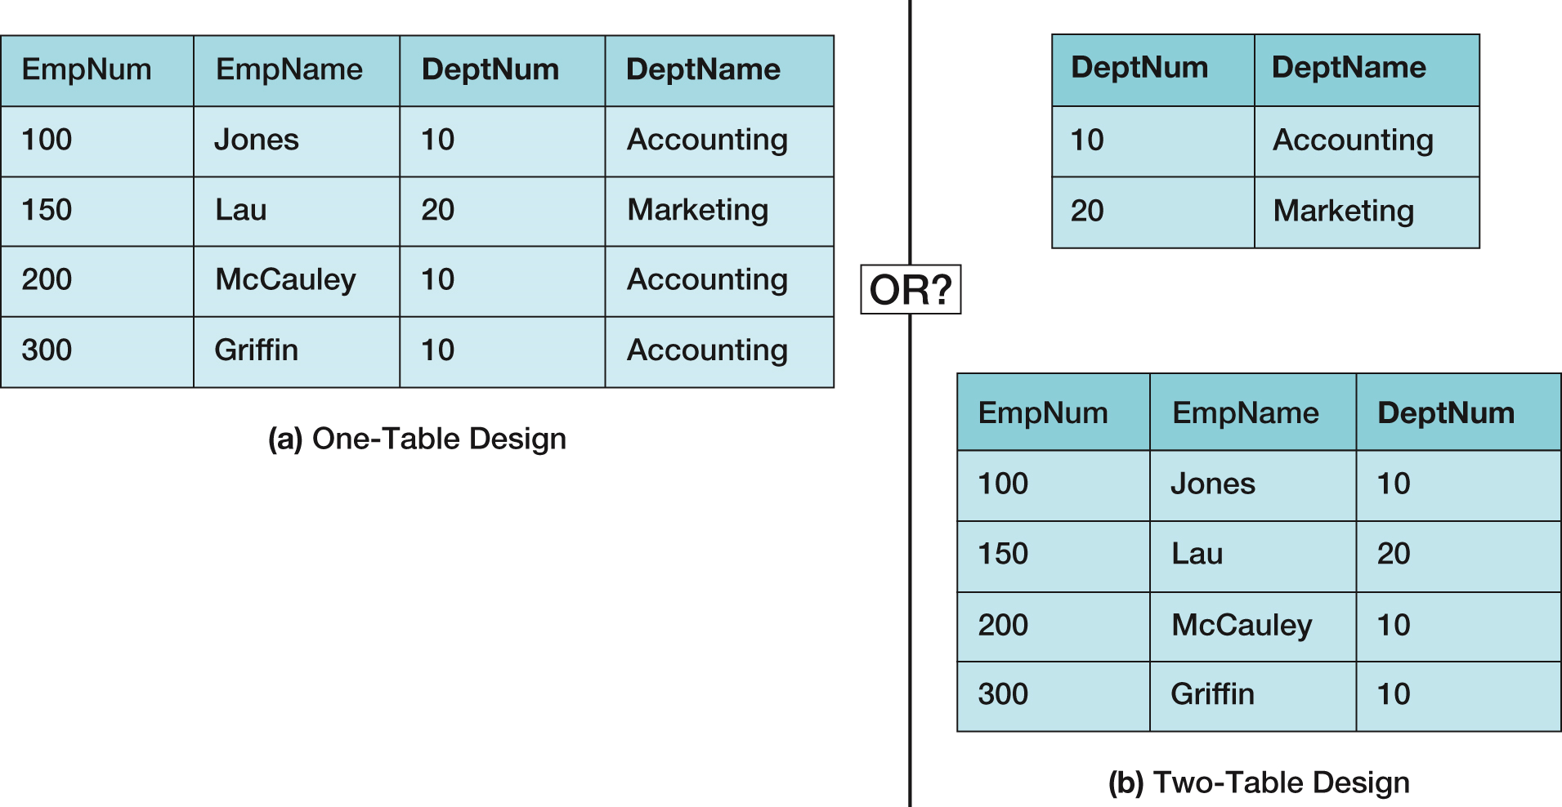
Figure 1-22 Data Import: One or Two Tables?

Slide 40
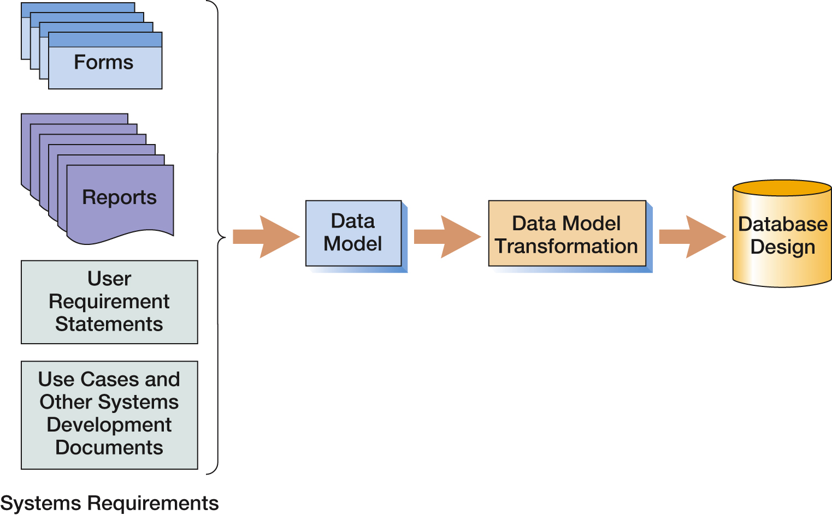
Figure 1-23 Database Originating from New Systems Development
Entity-Relationship data modeling is covered in Chapter 5, and data model transformations to database designs are covered in Chapter 6.

Slide 41
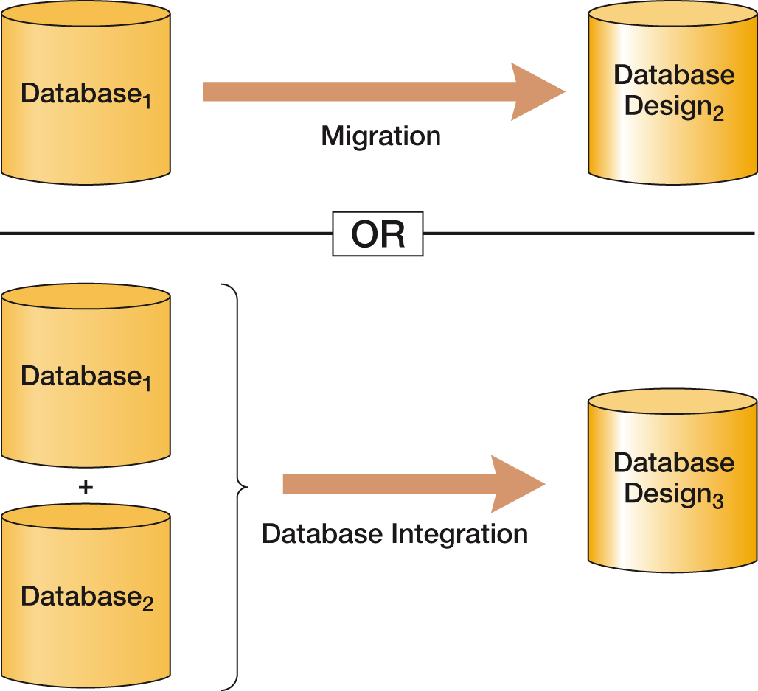
Figure 1-24 Databases Originating from Database Redesign

Slide 42
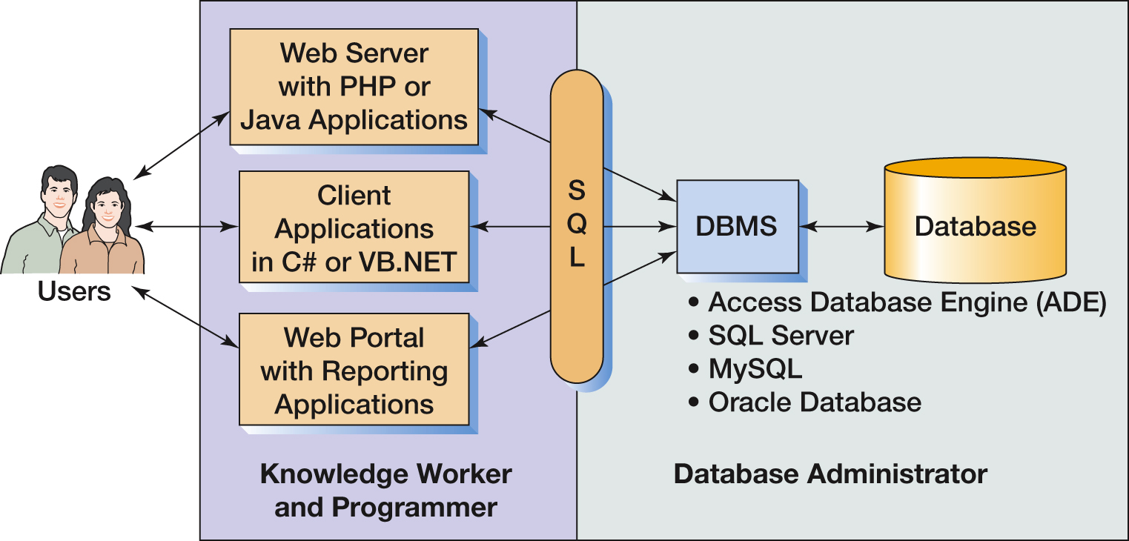
Figure 1-25 Working Domains of Knowledge Workers, Programmers, and Database Administrators

Slide 43
Figure 1-26 Priorities of What You Need to Know
Topic | Chapter | Importance to Database Administrator | Importance to Knowledge Worker and Programmer
Basic SQL | Chapter 2 | 1 | 2
The relational database model | Chapter 3 | 2 | 2
Design via normalization | Chapter 4 | 2 | 1
Data models | Chapter 5 | 2 | 1
Data model transformation | Chapter 6 | 2 | 1
SQL DDL and constraint enforcement | Chapter 7 | 3 | 1
Database redesign | Chapter 8 | 3 | 1
Database administration | Chapter 9 | 3 | 1
SQL Server, Oracle, MySQL specifics | Chapters 10, 10A, 10B, 10C | 3 | 1
Database application technology | Chapters 11, 12 | 1 | 3

Slide 44
Figure 1-27 Database History (1 of 2)
Era | Years | Important Products | Remarks
Predatabase | Before 1970 | File Managers | All data were stored in separate files. Data integration was very difficult. File storage space was expensive and limited.
Early Database | 1970-1980 | ADABAS, System2000, Total, IDMS, IMS | First products to provide related tables. CODASYL DBTG and hierarchical data models (DL/I) were prevalent.
Emergence of relational model | 1978-1985 | DB2, Oracle Database, Ingres | Early relational DBMS products had substantial inertia to overcome. In time, the advantages weighed out.
Microcomputer DBMS products | 1982-1992+ | dBase-II, R:base, Paradox, Microsoft Access | Amazing! A database on a micro. All micro DBMS products were eliminated by Microsoft Access in the early 1990s.
Object-oriented DBMS | 1985-2000 | Oracle ODBMS, Gemstone, O2, Versant | Never caught on. Required relational database to be converted. Too much work for perceived benefit.

Slide 45
Figure 1-27 Database History (2 of 2)
Era | Years | Important Products | Remarks
Web Databases | 1995-Present | IIS, Apache, PHP, ASP.NET, and Java | Stateless characteristic of HTTP was a problem at first. Early applications were simple one-stage transactions. Later, more complex logic developed.
Open source DBMS products | 1995-Present | MySQL, PostgresQL, and other products | Open source DBMS products provide much of the functionality and features of commercial DBMS products at reduced cost.
XML, and Web services | 1998-Present | XML, SOAP, WSDL, UDDI, and other standards | XML provides tremendous benefits to Web-based database applications. Very important today. May replace relational databases during your career. See Chapter 11 and Appendix I.
Big Data and the NoSQL movement | 2009-present | Hadoop, Cassandra, Hbase, CouchDB, Arango DB, MongoDB, JSON and other products | Web applications such as Facebook and Twitter use Big Data technologies. The NoSQL movement is geared toward processing large data sets using NoSQL data models which replace relational databases with nonrelational data structures such as XML and JSON, and which may supplant relational databases during your career. See Chapter 12 and Appendices K and L.

Slide 46
The Relational Database Model
The dominant database model is the relational database model—all current major DBMS products are based on it.
It was created by IBM engineer E. F. Codd in 1970.
It was based on mathematics called relational algebra.
This text examines and explains the relational database mode.

Slide 47
The NoSQL Movement and Big Data
Recent developments in Internet and mobile computing have resulted in the development of non-relational DBMSs.
NoSQL movement
Big Data
These do not replace the relational model, but rather complement it.
These topics are discussed in Chapter 12 and Appendix I.

Slide 48
Database Processing Fundamentals, Design, and Implementation (15th Edition)
End of Presentation:
Chapter One

Slide 49


